Slide 1


ENEL1ED: Plot of Temperature vs Time graph of LM35 sensor
GROUP 5

Slide 2
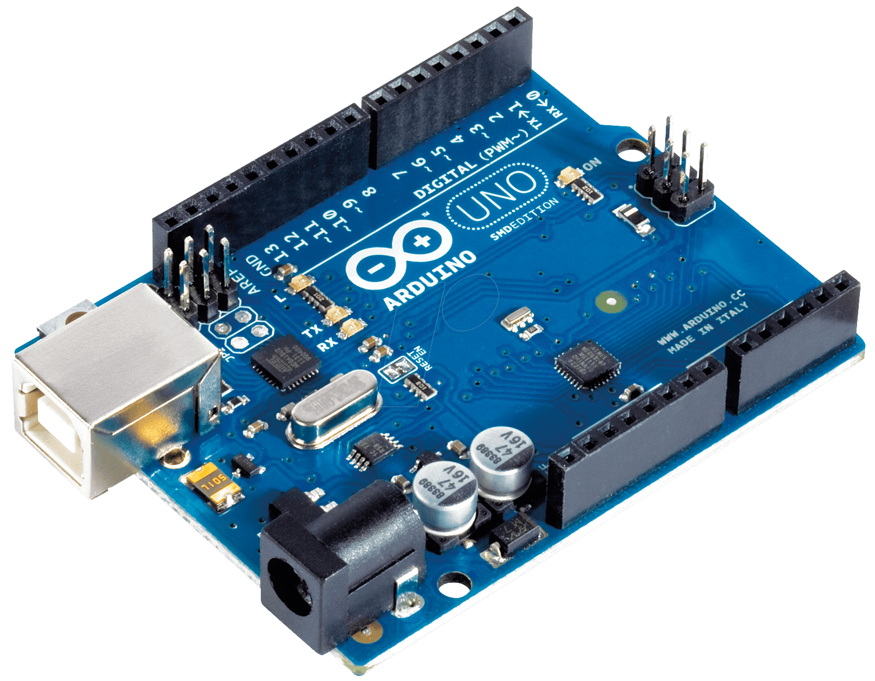
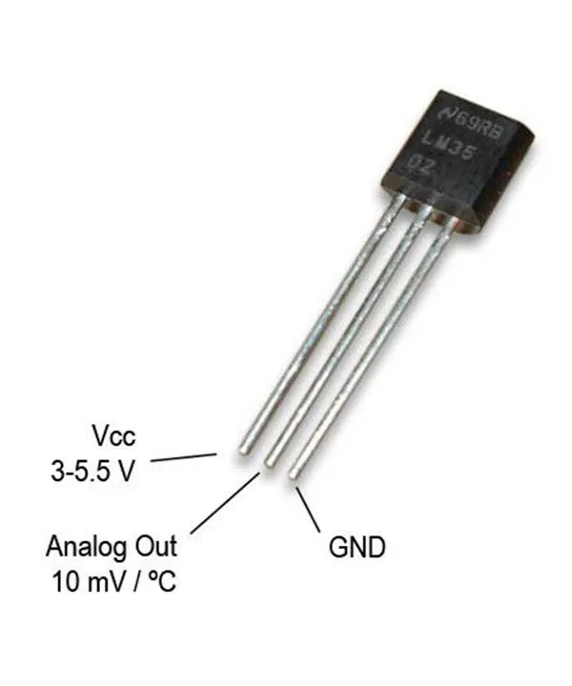
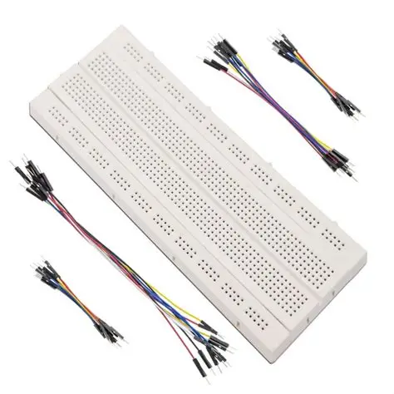

Components Used
Arduino Uno
LM35 Transistor
Breadboard and Jumper wires
reads the electrical signal coming from the LM35 and instantly send that data to our computer and MATLAB
This transistor is used as a temperature chip. We use it because its output is a simple voltage signal that easily converts to Celsius
These simply hold the sensor and the wires in place to ensure a reliable connection to the Arduino's power, ground, and signal pins

Slide 3

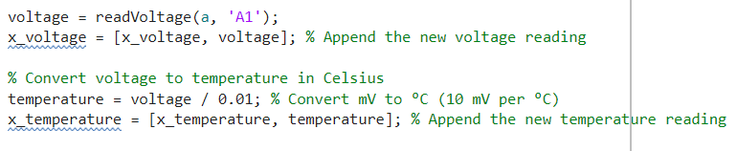
Converting the Voltage readings into Temperature(°C)
We used MATLAB's hardware support package to connect to the Arduino
The voltage readings are then collected using the readvoltage() function and stored in the x_voltage array, where values are constantly added
a is the Arduino object we created at the start of the script. 'A1' specifies the analog pin on the Arduino where we connected the LM35's output.
The LM35 has a conversion factor of 10 millivolts per degree Celsius (10 mV/°C).
After the conversion, the temperature readings are stored in the x_temperature array,

Slide 4

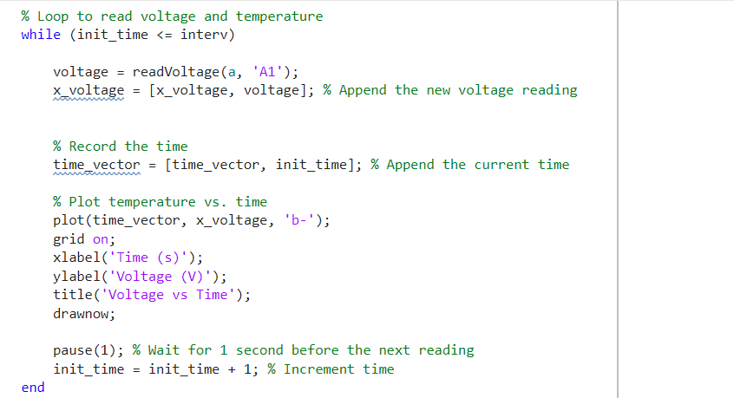
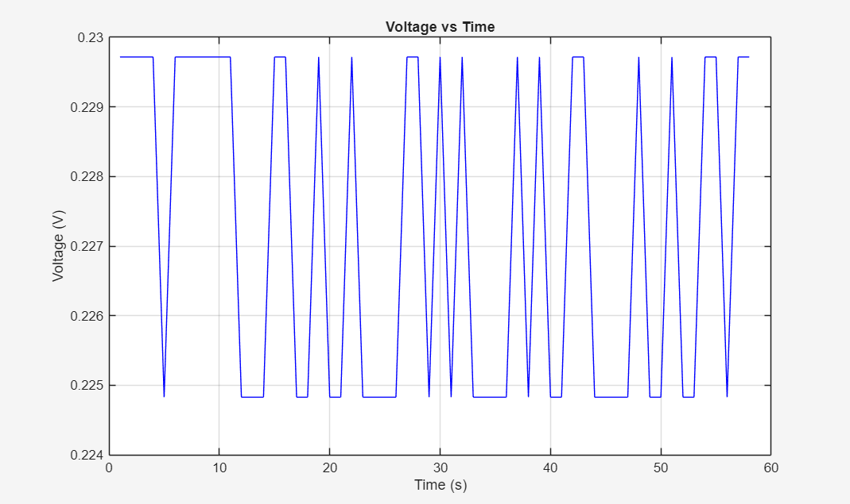
Plotting Voltage vs Time gragh
We use plot(time_vector, x_voltage, 'b-') inside the while loop to visualize the Voltage vs. Time graph continuously.
Where the time_vector is an array that is constantly updated with the init_time variable that is incremented within the while loop
The drawnow command is critical; it forces MATLAB to refresh the figure window in every iteration, enabling the real-time plotting effect.
The x - axis is labeled 'Time (s)' and the y-axis is labeled ‘Voltage (V)', providing clear context for the data.
The pause (1) allows for smoother plotting and also provides a second pause which allows data to be updated by the second

Slide 5
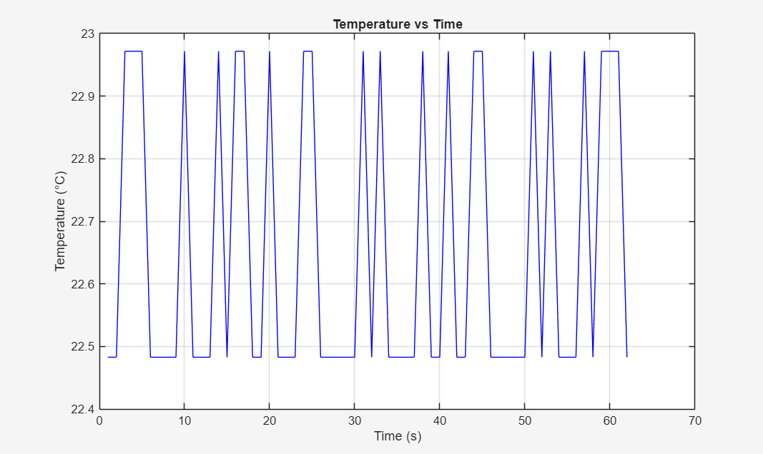
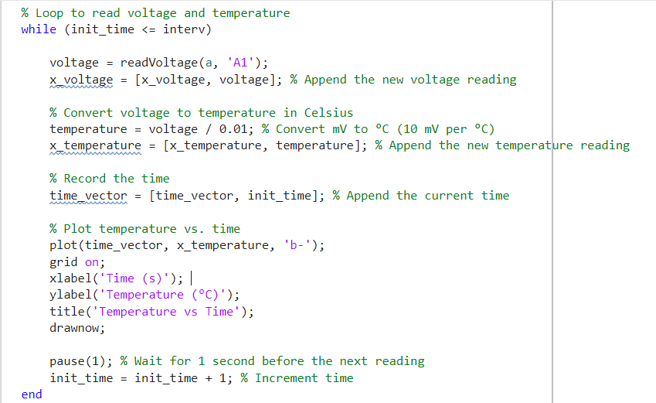
Plotting the Temperature vs Time graph from Voltage vs Time graph
The essential step is converting the raw voltage into temperature using the LM35's 10 mV/°C factor. In MATLAB, this is simple division: temperature = voltage / 0.01 discussed prior
Now instead of the x_voltage array, the x_temperature array is now plotted against the time_vector,
We then plot the converted data using plot(time_vector, x_temperature, 'b-'). The y-axis now accurately represents the temperature in degrees Celsius (°C)
Comparing the 2 graphs, we see they have similar fluctuations and behavior for similar environments(e.g. at room temp) due to the LM35’s linear relationship between the voltage and temperature

Slide 6
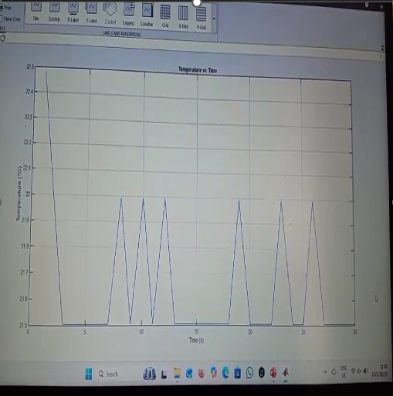
Testing/Evaluation: At Room Temperature
Test was conducted in an air-conditioned room (Library)
Temperature fluctuates between 21 and 22°C with 0,5°C ‘steps’ due to the Analog-to-Digital Converter (ADC) resolution
The test was conducted for about 5 minutes
Fluctuations that are out of range (21,5 ±0,5°C ) are due to environmental factors such as noises and Electromagnetic interference from nearby motors, phone
Note: To see the video results, please use the link attached to the ‘README’ document

Slide 7
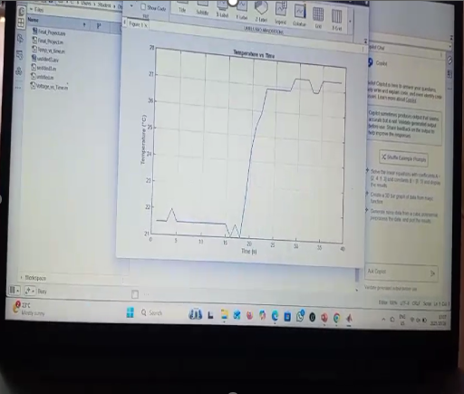
Testing/Evaluation: Touching the Sensor
Test was conducted in an air-conditioned room (Library)
The sensor was held at t = 20s with thumb and pointing finger
The human body temperature is about 37 °C but that is the temp at the core, the temp by the limbs drops as you move away from the core(abdomen and chest area)
The test was conducted for about 5 minutes
After releasing the sensor, the temperature doesn’t immediately drop as the heat that has built up by the sensor is slowly dissipating until thermal equilibrium is reached between the environment and the sensor
Note: To see the video results, please use the link attached to the ‘README’ document

Slide 8
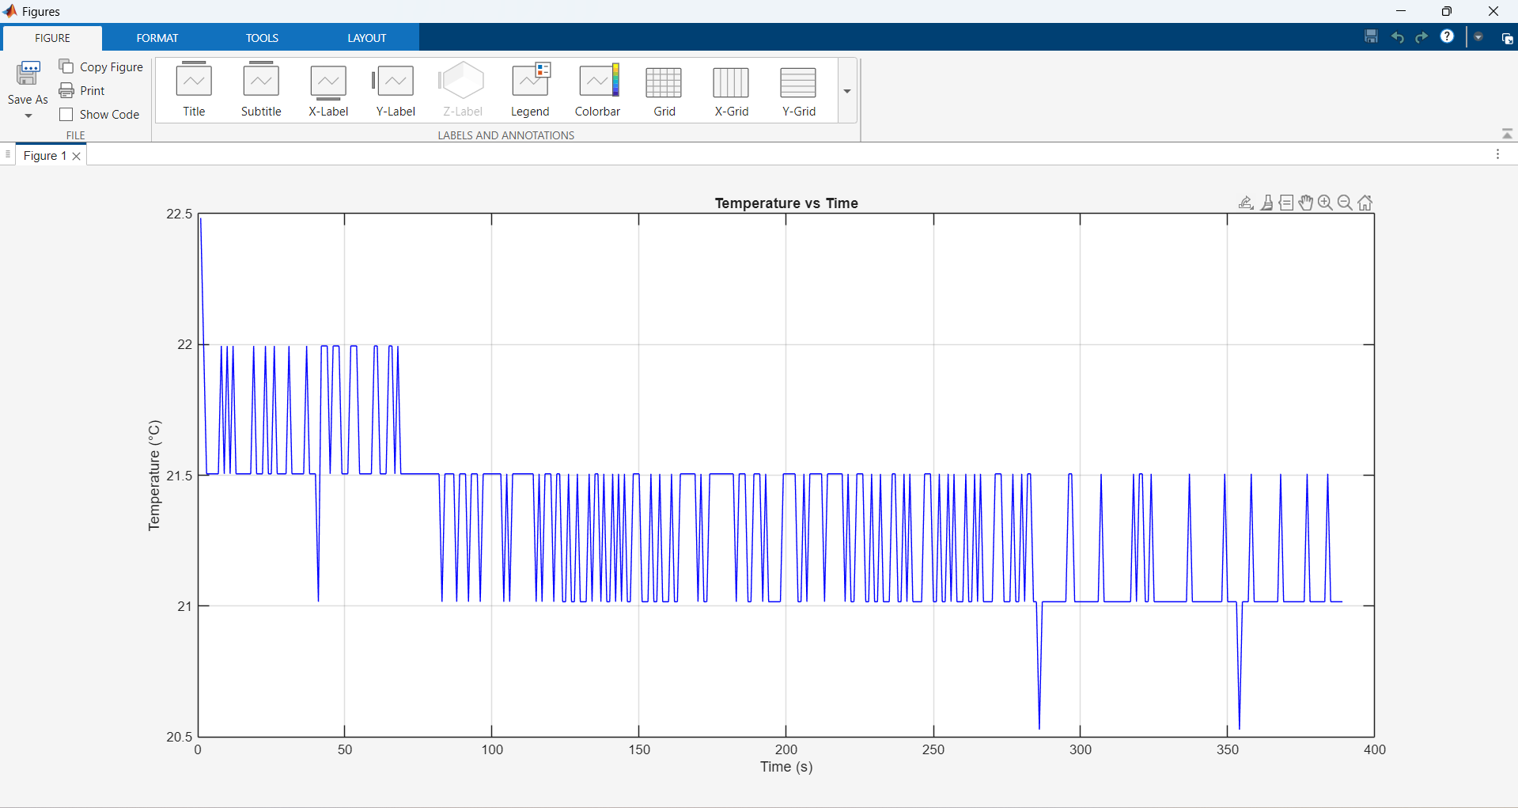
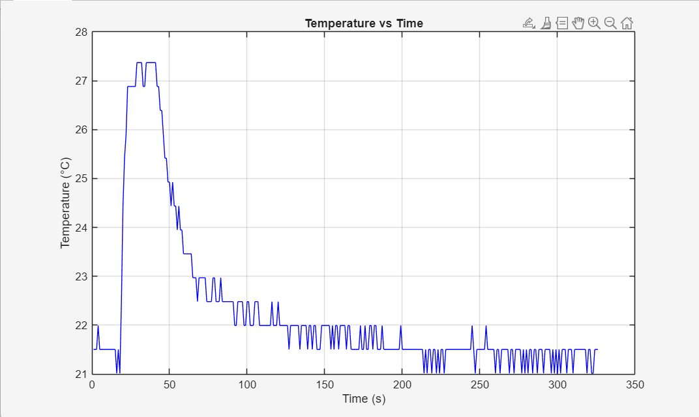
Results after 5 Minutes
At room temperature
With the sensor touched

Slide 9


Brought to you by:
Mholi Biyela(225159691)
Okwami Cele(225060127)
Samukelo Jili(225004064)
Thokozani Matlala(225141078)
Khulakahle Mazibuko(225093096)

